Slide 1

Web browser
Prepared by Mohammad fawad

Slide 2
presentation Content
What is a web browser?
Who invented the first web browser?
Why do we use web browser?
Types of web browser?

Slide 3

What is a web browser?
A web browser is a software application that allows you to access and view websites on the internet. Popular web browsers include Google Chrome, Mozilla Firefox, Apple Safari, and Microsoft Edge. These browsers interpret code written in HTML, CSS, and JavaScript to render web pages and display them for you to see. Essentially, a web browser acts as a gateway between you and the internet, allowing you to navigate and interact with websites.

Slide 4
Example of web browser:
using System;
using System.Windows.Forms;
namespace MyWebBrowser
{
public partial class Form1 : Form
{
public Form1()
{
InitializeComponent();
}
private void Form1_Load(object sender, EventArgs e)
{
webBrowser1.Navigate("https://www.google.com/"); // Navigate to Google.com on load
}
private void button1_Click(object sender, EventArgs e)
{
webBrowser1.Navigate(textBox1.Text); // Navigate to the URL entered in the text box
}
}
}

Slide 5
Who invented the first web browser?
The first web browser was invented by Sir Tim Berners-Lee in 1990 while he was working at CERN, the European Organization for Nuclear Research. The browser was called WorldWideWeb and was designed as a way for researchers to share information across a network of computers. It was later renamed Nexus to avoid confusion with the World Wide Web itself, and it was eventually discontinued as newer and more advanced web browsers were developed. However, Berners-Lee's invention was a key milestone in the development of the World Wide Web and the internet as we know it today.

Slide 6

Types of web browser
There are several web browsers available today, each with its own features and advantages. Some of the most popular web browsers include:
Google Chrome
Mozilla Firefox
Safari (developed by Apple)
Microsoft Edge (formerly known as Internet Explorer)
Opera

Slide 7
Web browser
These browsers are widely used and have a variety of features that make them popular among users. Google Chrome and Mozilla Firefox, for example, are known for their speed and flexibility, while Safari is popular among Mac users and Microsoft Edge is known for its compatibility with Windows operating systems. Opera, meanwhile, offers a range of unique features such as a built-in ad blocker and VPN.

Slide 8
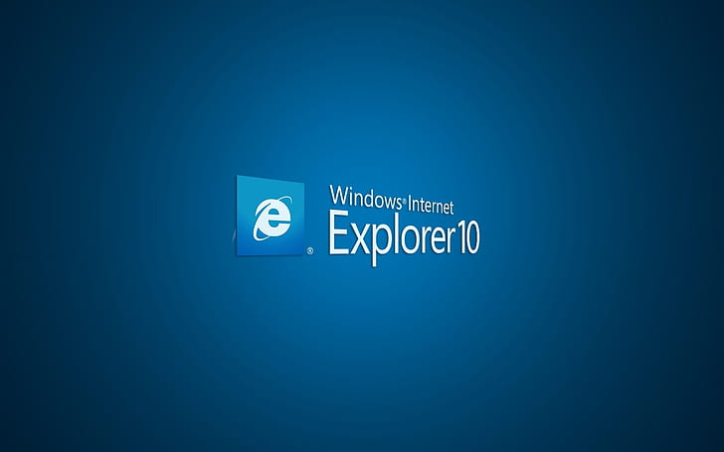
Thank you
Rana university

